Slide 1



Tooltips
View in Power BI
Last data refresh:
7/29/2023 3:35:00 PM UTC
Downloaded at:
7/29/2023 4:34:12 PM UTC

Slide 2
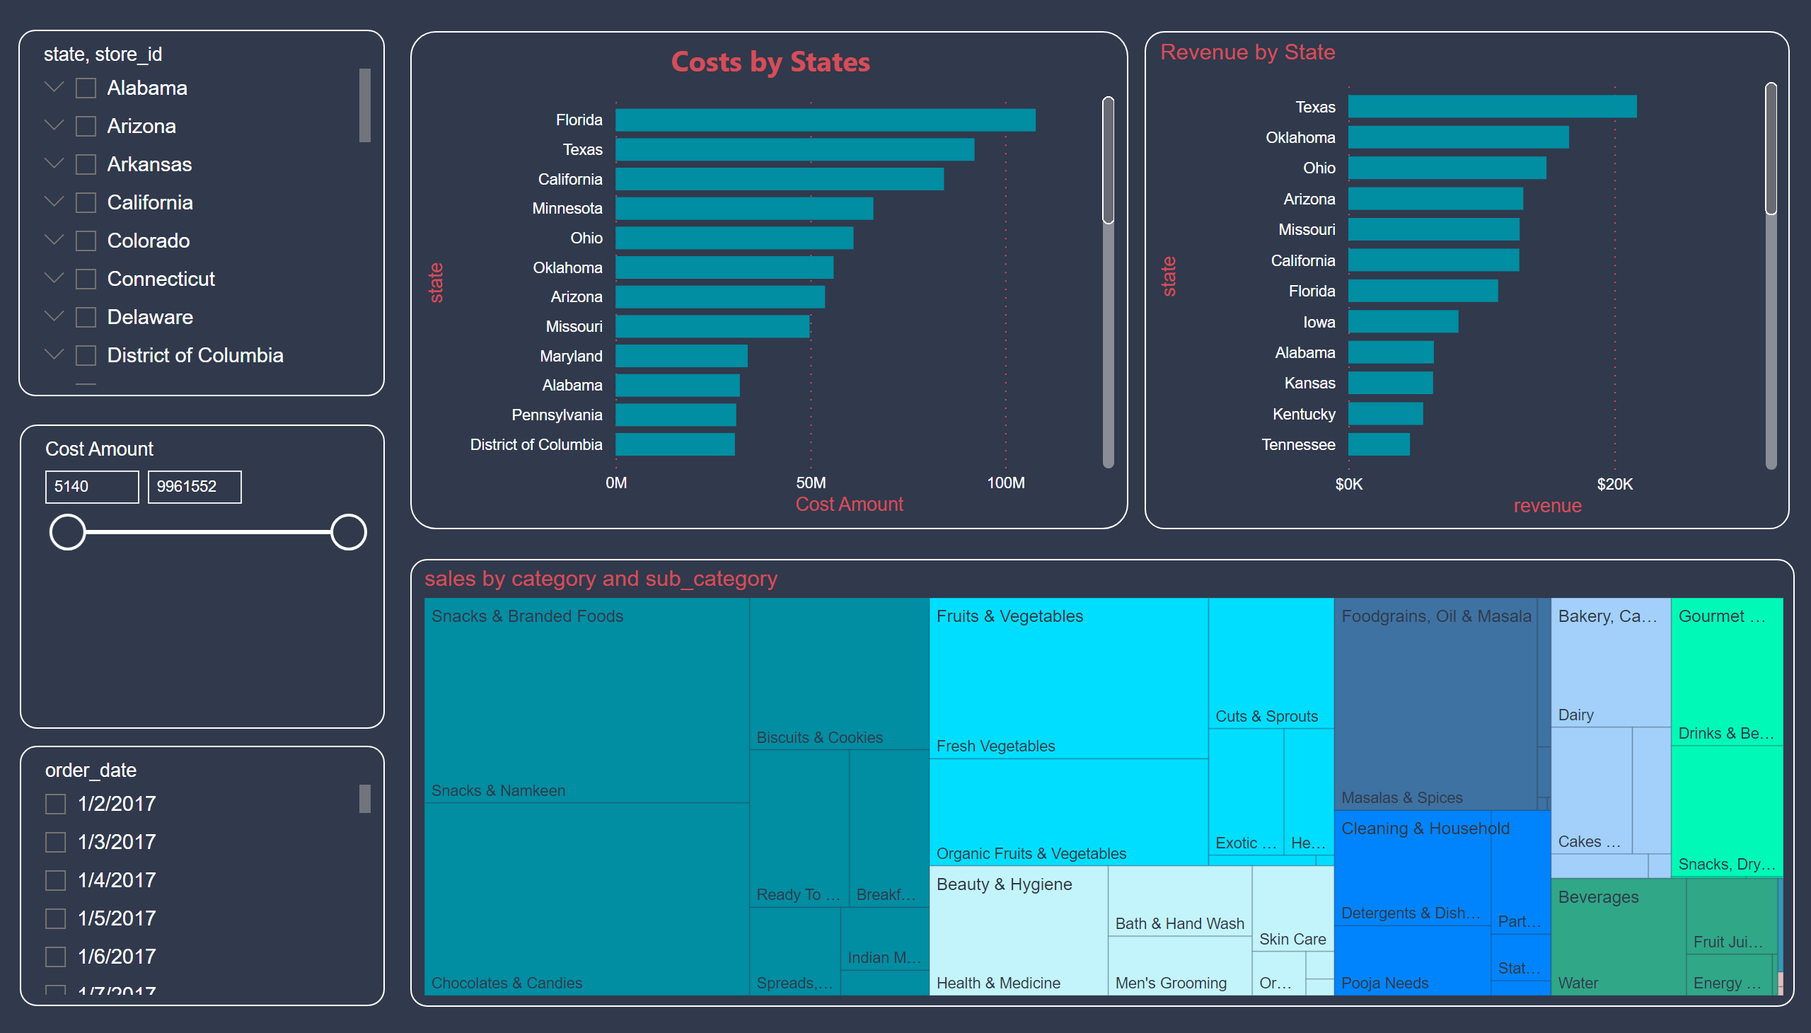
Overview
Notes:
Costs by States
No alt text provided
slicer
No alt text provided
slicer
No alt text provided
slicer
No alt text provided
Revenue by State
No alt text provided
treemap
No alt text provided

Slide 3
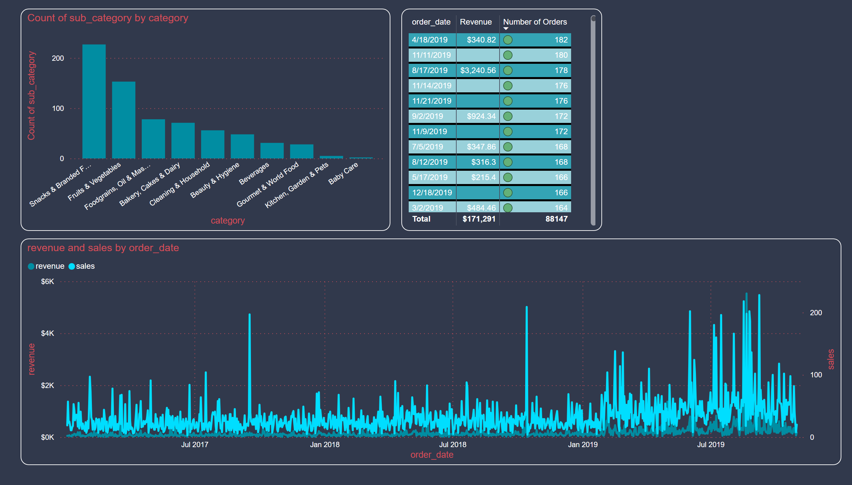
Revenue with Dates and Sub-categories
Notes:
columnChart
No alt text provided
lineChart
No alt text provided
tableEx
No alt text provided

Slide 4
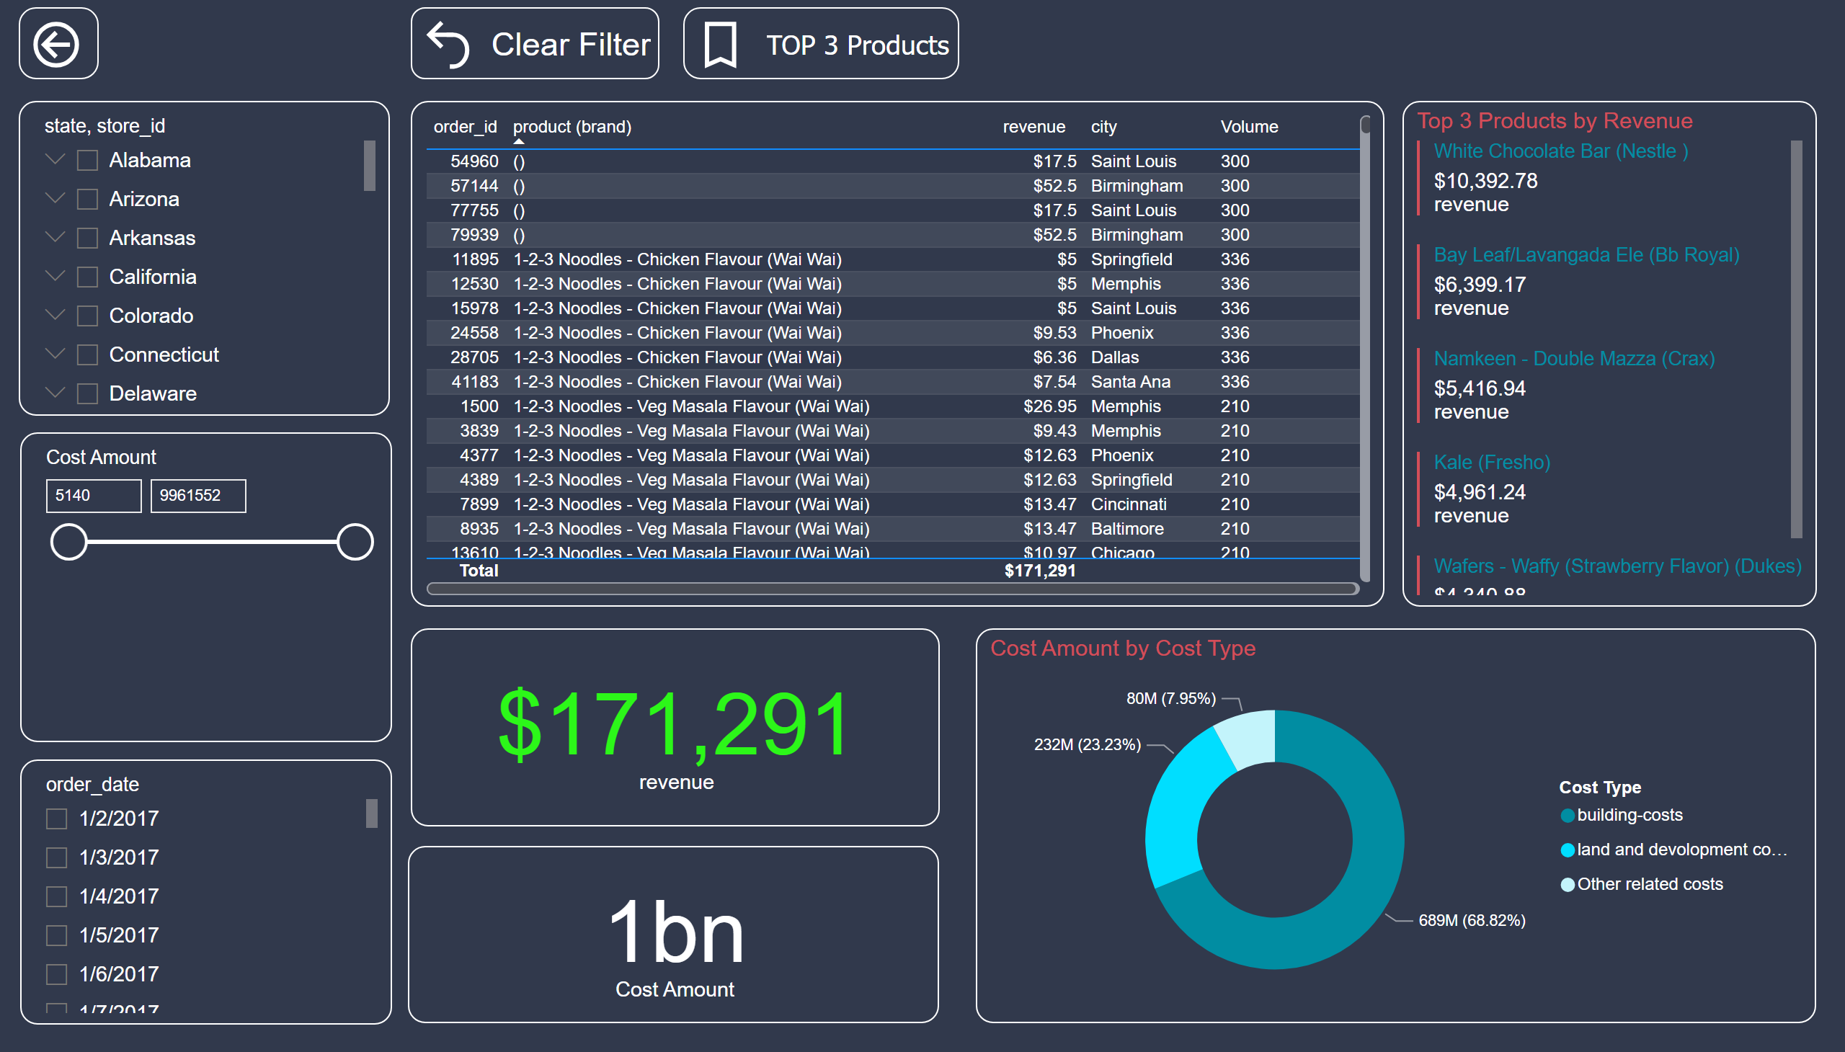
Details
Notes:
slicer
No alt text provided
slicer
No alt text provided
slicer
No alt text provided
actionButton
No alt text provided
tableEx
No alt text provided
actionButton
No alt text provided
actionButton
No alt text provided
card
No alt text provided
Top 3 Products by Revenue
No alt text provided
donutChart
No alt text provided
card
No alt text provided

Slide 5
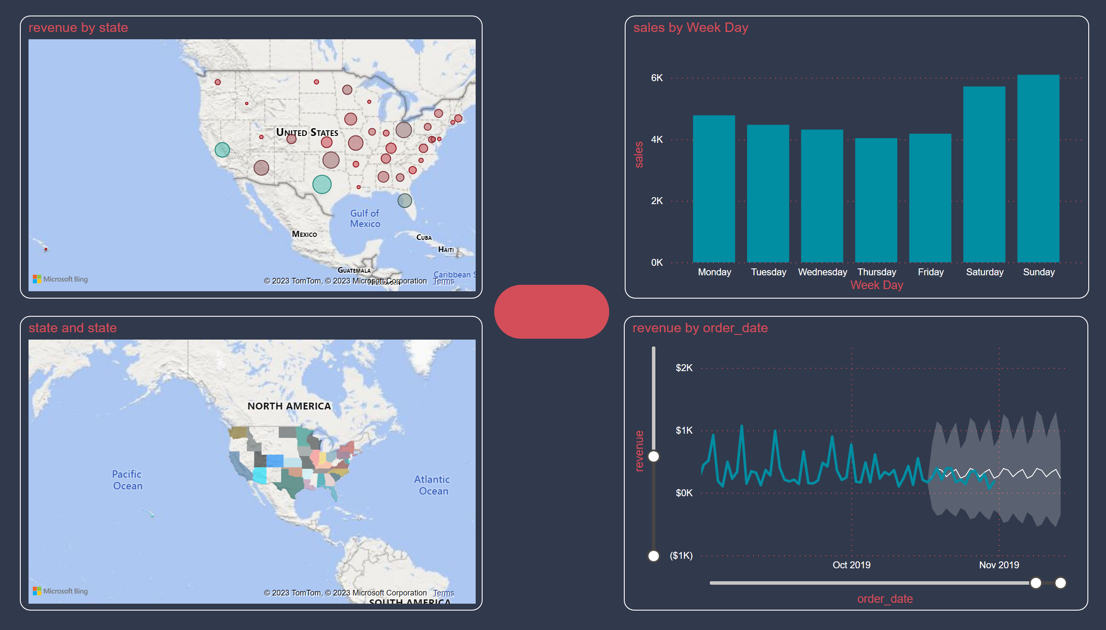
Maps and Forcasts
Notes:
columnChart
No alt text provided
map
No alt text provided
filledMap
No alt text provided
lineChart
No alt text provided
actionButton
No alt text provided

Slide 6
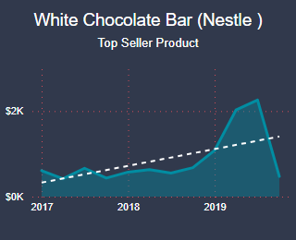
Tooltip Top Product
Notes:
card
No alt text provided
areaChart
No alt text provided

